Slide 1
The battle of neighborhood
Business Problem

Slide 2
Introduction –Bangkok
Bangkok is the capital of Thailand
It has a growing population of more than 8 millions people
Its number of visitors is over 22 millions people and constantly growing
Its food offer is limitless

Slide 3
Introduction – How it starts
An Italian entrepreneur wants to open an Italian restaurant in the city of Bangkok
She has read of the great success of Pala Pizza Romana, a pizza place opened in 2011 in the district of Watthana, at the direct exit of the Asok BTS Skytrain station
She wants to offer pizza (whole and in quarters), gelato (the Italian ice-cream) and espresso (the Italian short coffee), plus other specialties that the market will suggest

Slide 4
Introduction – BTS
The Bangkok mass Transit System (BTS) is an elevated rapid transit system (cit. Wikipedia), consisting of 2 lines:
Sukhumvit Line
Silom Line
Bangkok is a capital with more than 10 million people and, as many Asian metropolises, is often congested with traffic
Using the car there is often impossible and the only alternative to bikes is BTS (and its old underground version: MRT)
Asok is a stop of the Sukhumvit Line

Slide 5
Introduction – The Challenge
The entrepreneur has previously selected four BTS stops, to open her restaurant:
Ari (Sukhumvit Line)
Ekkamai (Sukhumvit Line)
Thong Lo (Sukhumvit Line)
Surasak (Silom Line)
They bring to 4 neighborhoods, trendy and full of expats
She found two available spots in Ari and Thong Lo
She wants to choose between these two spots, that have prices comparable (Thong Lo is more expensive but smaller)
She asks us to analyze the competition in the two areas

Slide 6
Introduction – The questions
We need to look for existing restaurant and spots in a 500 mts radius from the BTS stop
The questions we are requested to answer are:
How many pizza places are actually there, with Italian-like names?
How many ice-cream shops are there, serving gelato?
How many coffee shops are there, serving espresso?

Slide 7
Data
We’ll use the Foursquare API to get venues and their location
We’ll look at their rating to exclude places that have a rating behind 6/10
The number of likes is another parameter we’ll consider, and the price, to exclude places that are considered ‘cheap’
We’ll scrape TripAdvisor to scrape the reviews of the best potential competitors of our place, creating a WordCloud
We’ll use the Folium library to show the location of the existing places

Slide 8
Methodology
Regarding pizza: there is a category in Foursquare – Pizza Place:
We’ll select every pizza place and then take only the one with Italian-like names
Regarding gelato: the category to start from is Ice-Cream Shop:
We will consider only places with the word ‘gelato’ in their name.
Regarding espresso: the category is Coffee Shop:
We will consider only places with the word ‘espresso’ in their name.

Slide 9
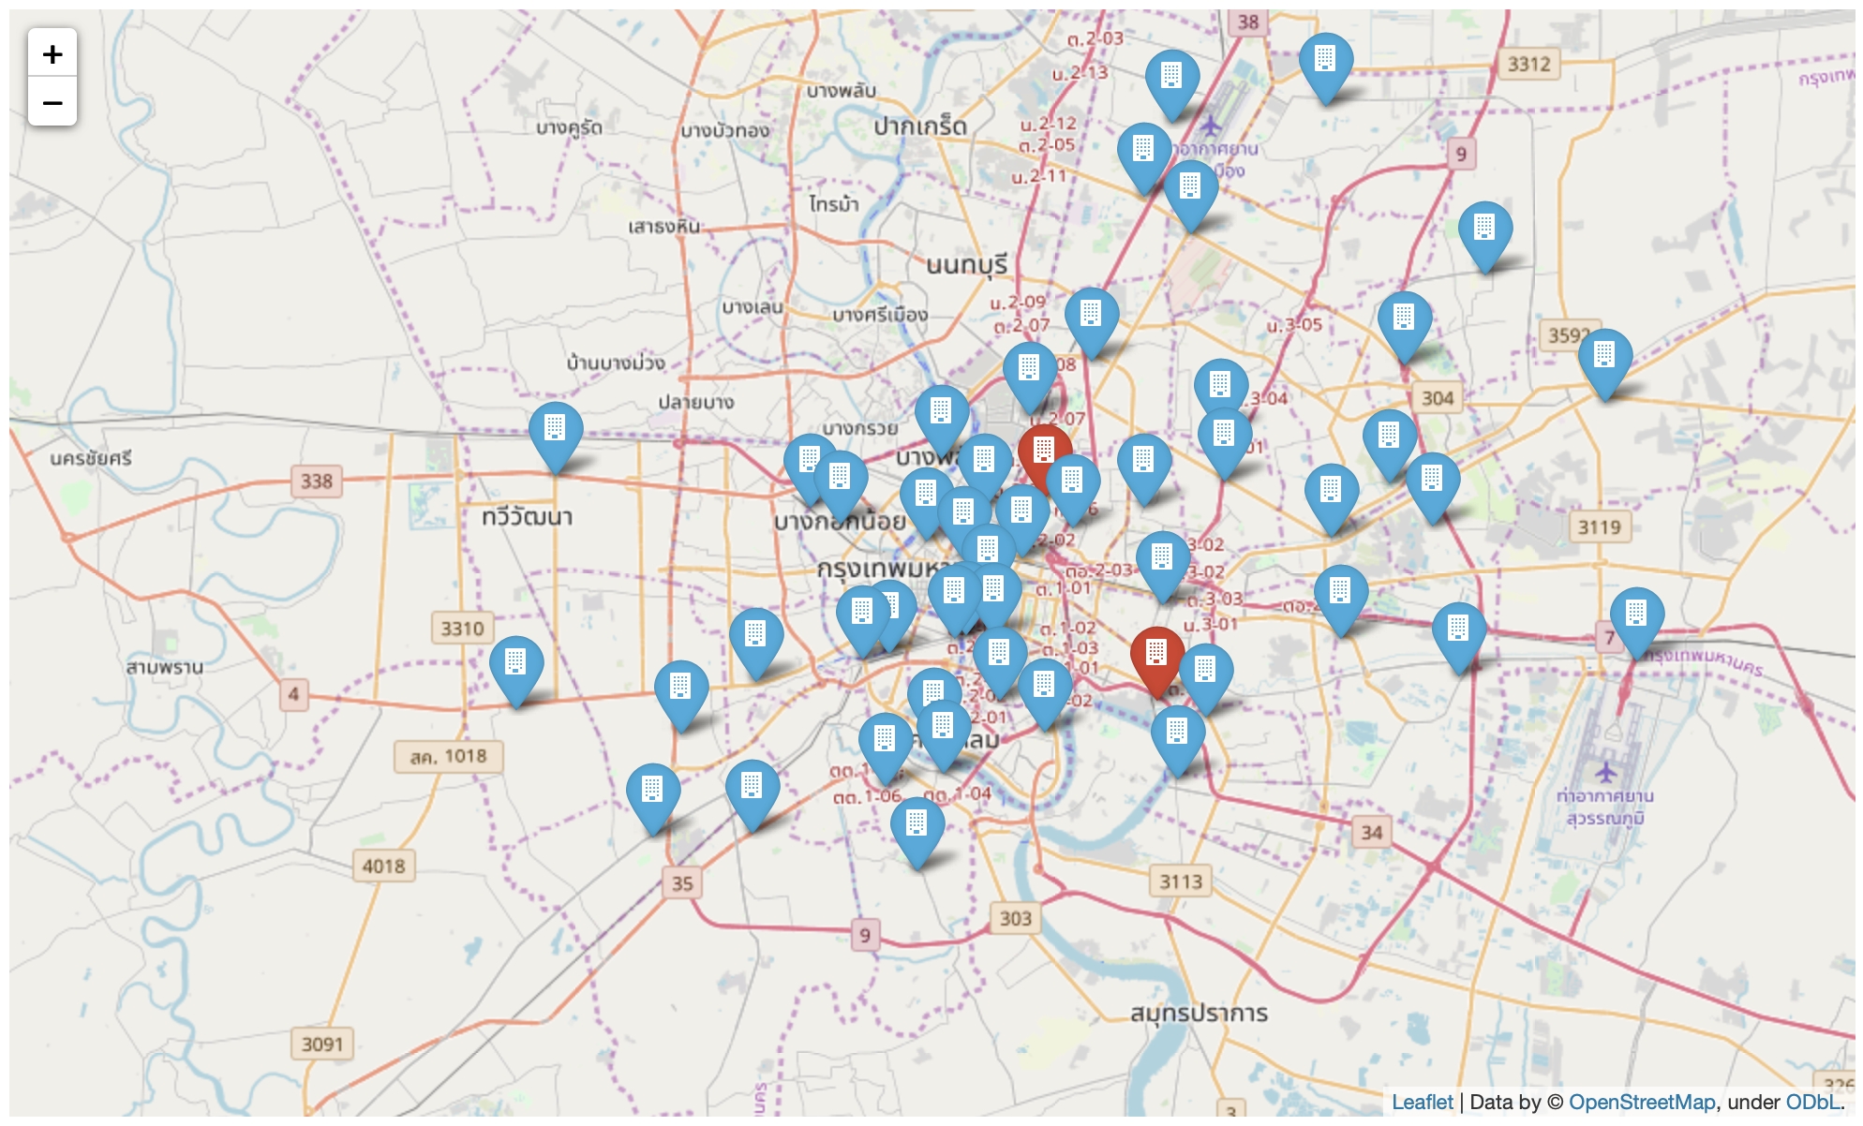
Map of Bangkok Districts – to show our areas

Slide 10
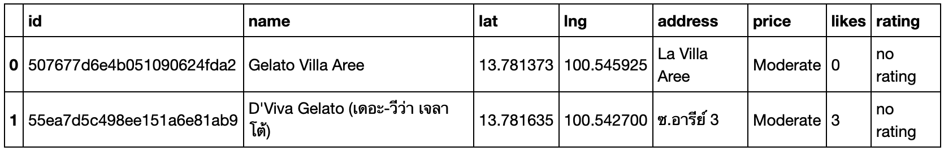
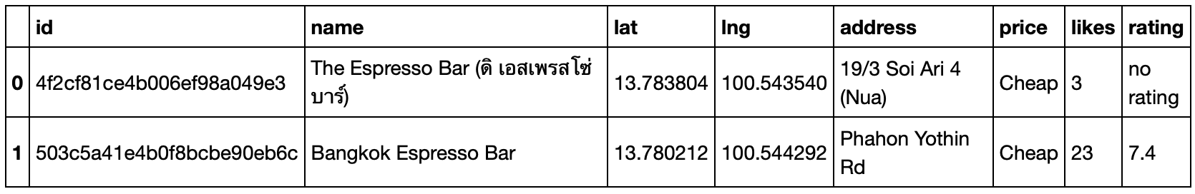
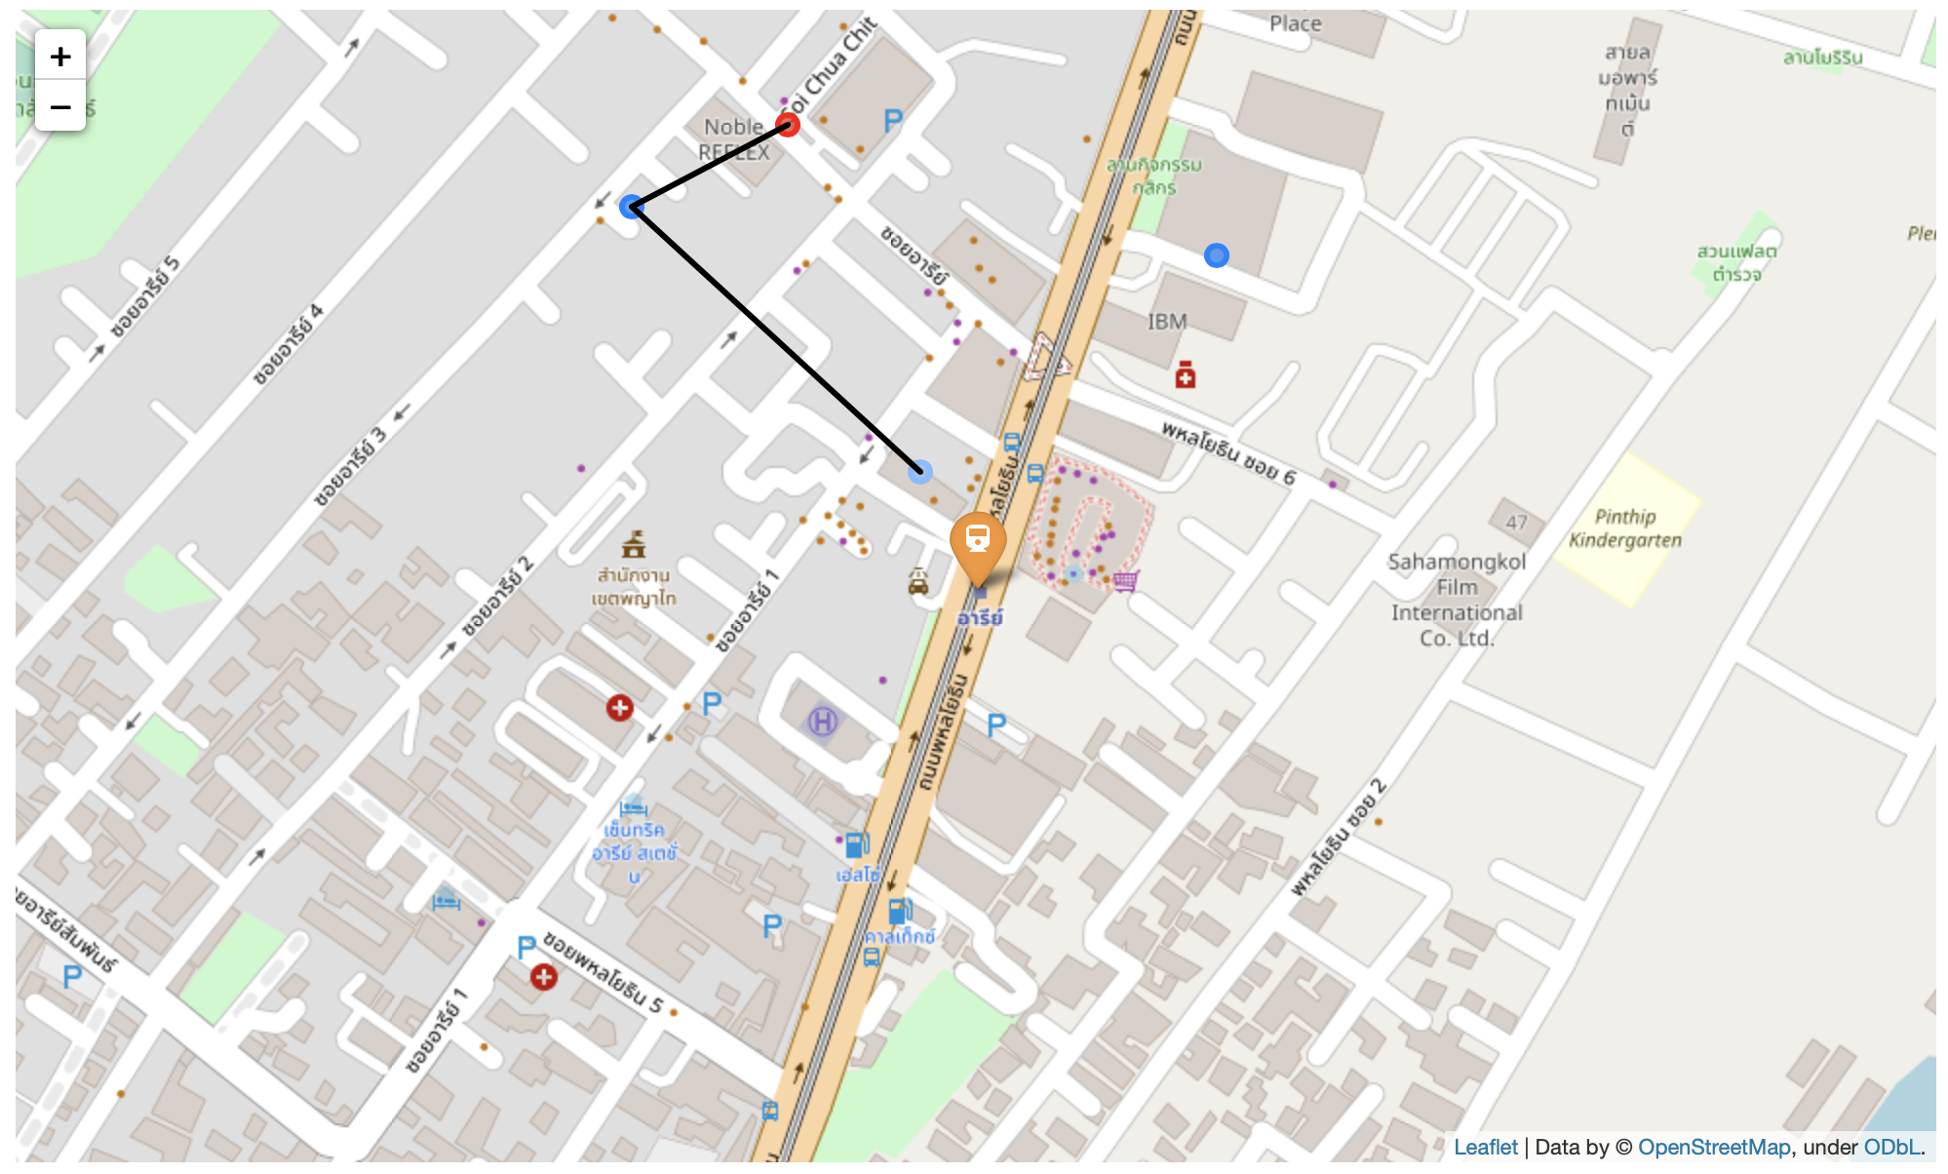
Ari BTS Stop

Slide 11
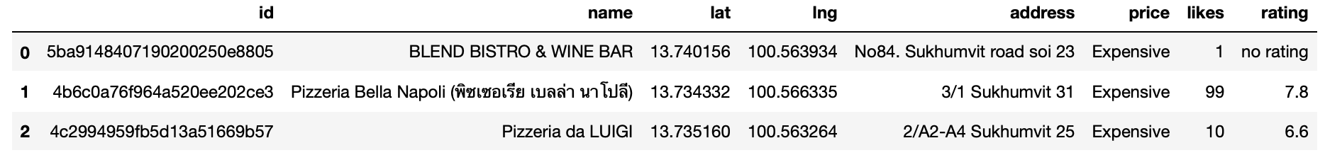
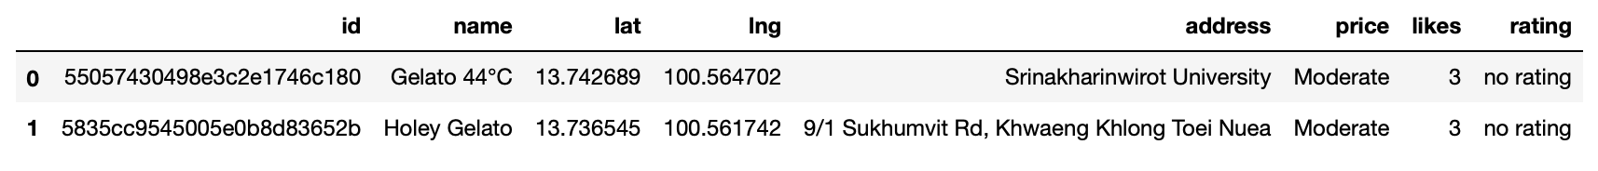
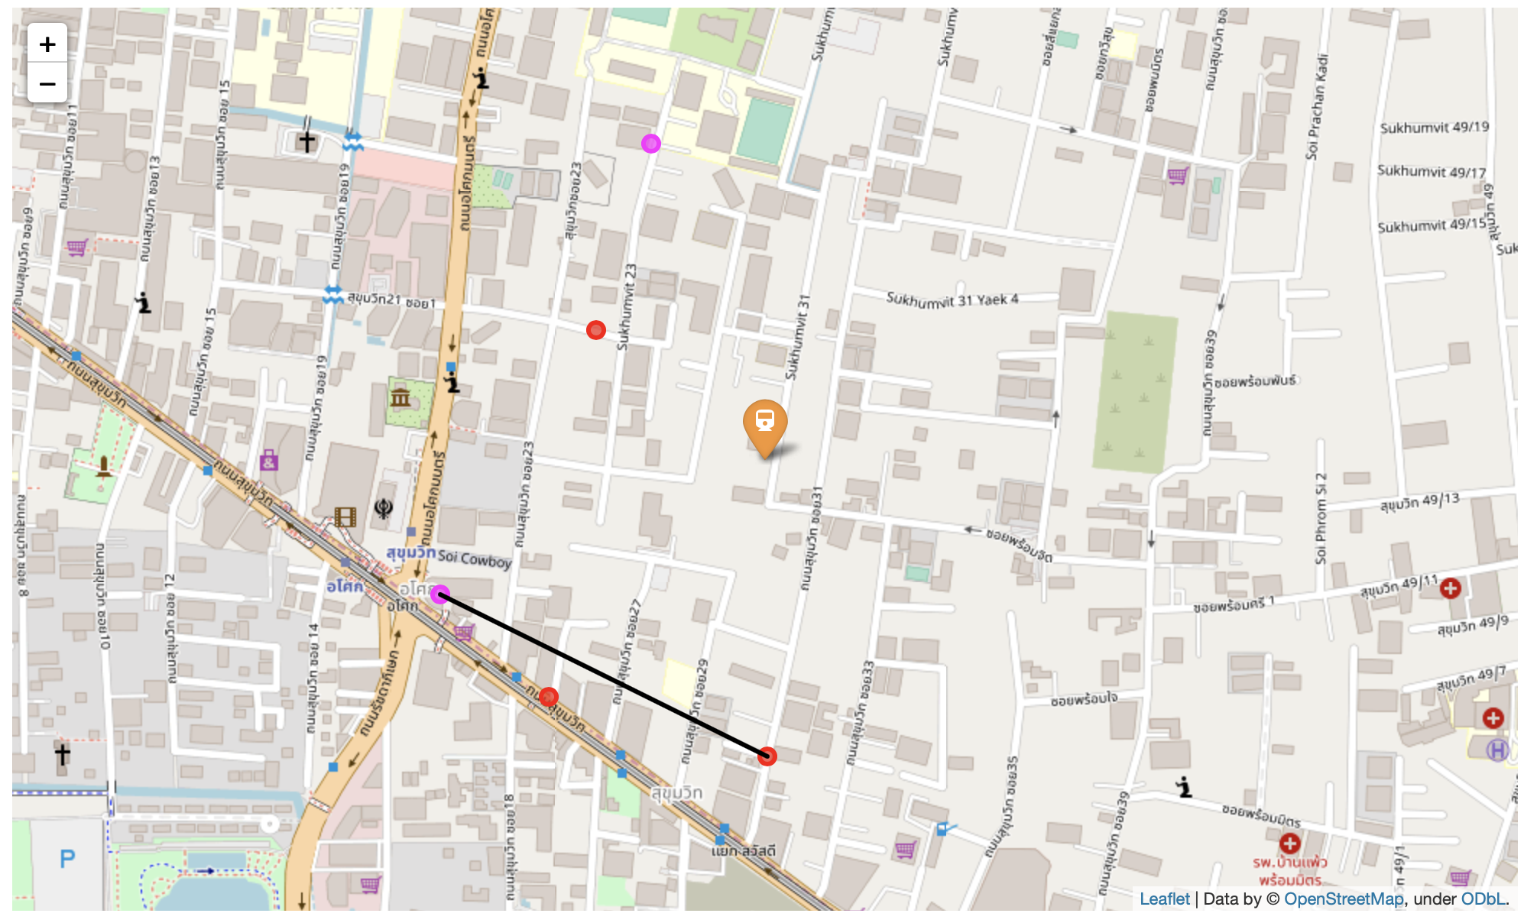
Thong Lo BTS Stop

Slide 12
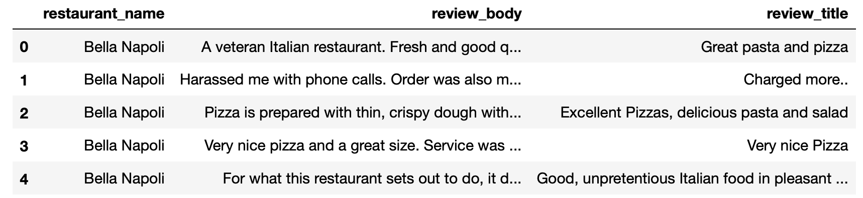
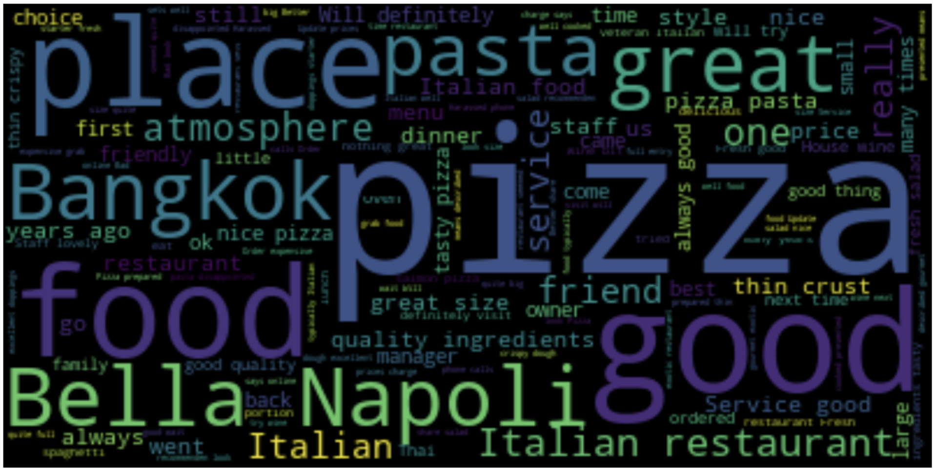
TripAdvisor Reviews

Slide 13
Conclusions
In summary, Ari offers gelato and espresso and a Pizza Place that, with a rating of 7.1/10, has only 6 reviews.
Pizzeria Bella Napoli, close to the Thong Lo BTS Stop, has a higher rating of 7.8/10, 472 reviews, with two of them directly talking of coffee, that in an Italian restaurant probably means 'espresso'. The area offers other two pizza places, one of them with an Italian name (Pizzeria Da Luigi).
After analysing these reviews, we might think that actually the Ari BTS stop could be a good choice as well.
In both areas, for different reasons, the competition doesn't look invincible:
Ari: The best and close pizza place, Basilico, has less reviews and a lower rating, but closer to the BTS stop.
Thong Lo: Pizzeria Bella Napoli is appreciated, but it's not so close. There are two other pizza places.
Both of these places don't offer slices of pizza.
I would still suggest Thong Lo, cause the competition is not too close, but just if we can open a place really close to the BTS Stop.

